Slide 1

Radial Basis Function
Neural Network Algorithm
Presented By: Aayushman Amatya

Slide 2
History
Radial Basis Function
1970s: The concept of RBFs was introduced in the field of approximation theory. The basic idea was to use radially symmetric functions (functions whose value depends only on the distance from a central point) to approximate multivariate functions.
1977: David E. Cox first introduced the concept of radial basis functions for multivariate interpolation in his Ph.D. thesis. He explored how these functions could be used to interpolate scattered data points in multiple dimensions.
1980: Richard L. Hardy popularized the use of RBFs for scattered data interpolation in geophysics and other fields. Hardy's work demonstrated that RBFs, particularly the multiquadric RBF, could provide smooth and accurate interpolations.

Slide 3
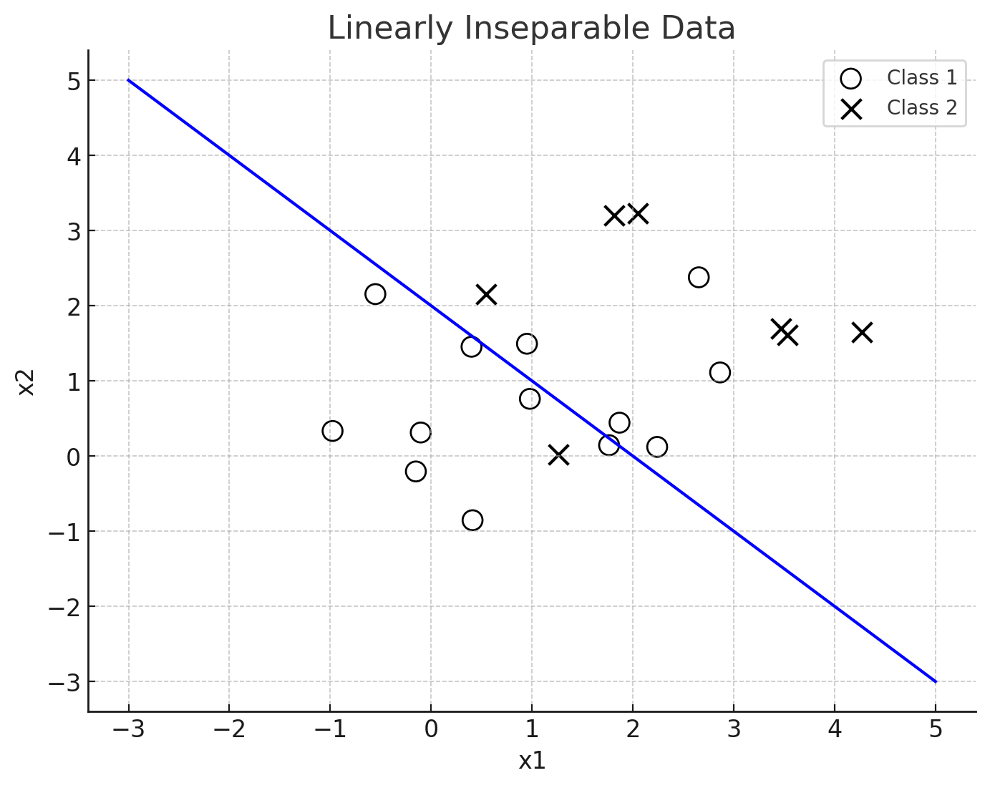
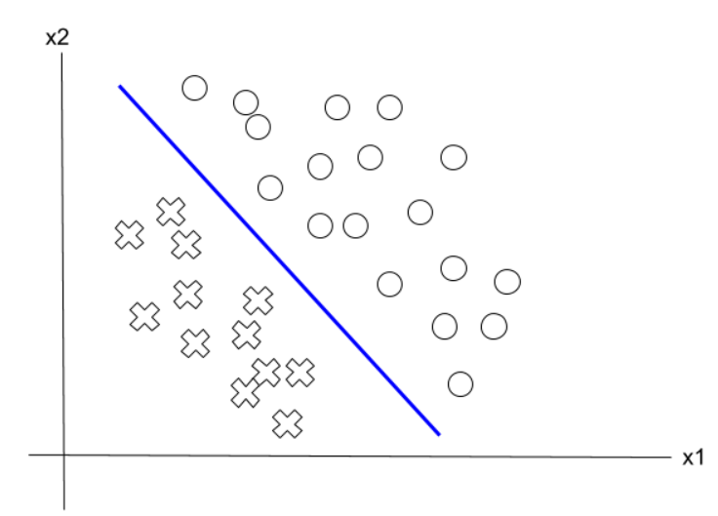
Introduction
Radical Basis Function
Linearly Separable
Non-Linearly separable

Slide 4
Introduction
Radial Basis Function
Data can be either linearly separable or non-linearly separable.
Single layer perceptron can be used for classifying linearly separable data.
Multi layer perceptron can be used for classifying non-linearly separable data.

Slide 5
Introduction
Radial Basis Function
Radial basis function is a type of multi layer perceptron which has one input layer, one output layer and only one hidden layer.
The hidden layer uses a non-linear radial basis function as a activation function, which converts the input parameter into high dimension space which is then fed into the network to linearly separate the problem.

Slide 6
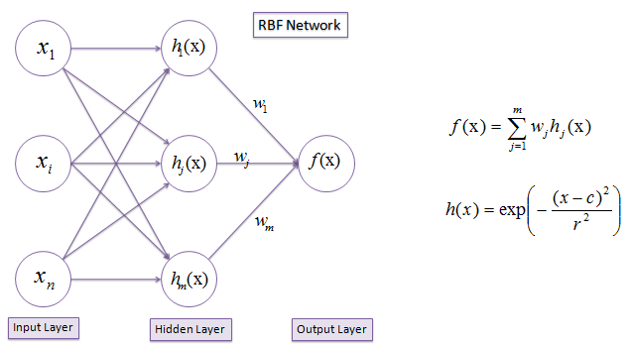
Radial Basis Function (network)

Slide 7
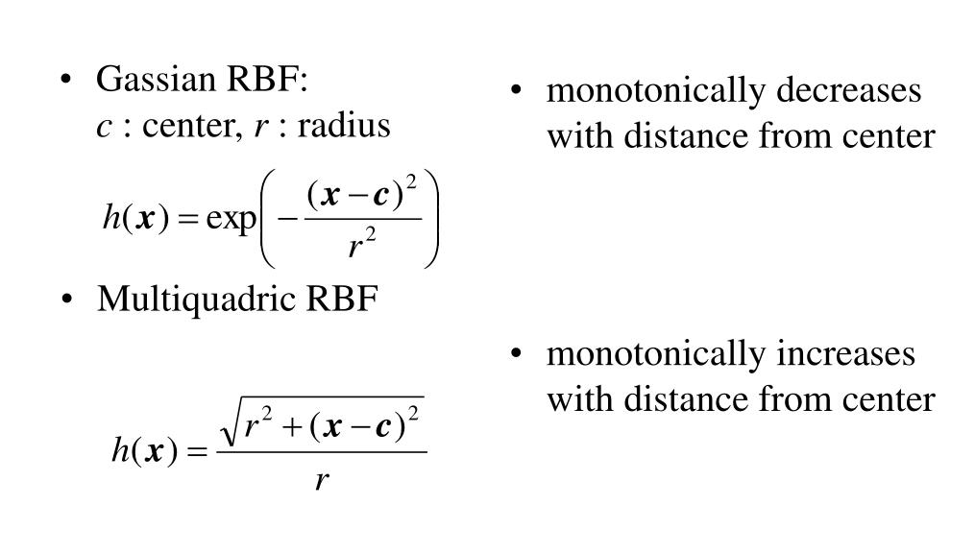
Mathematical Model

Slide 8
Real world Application
Radial Basis Function
Time series prediction and weather forecasting.
Adaptive control of robot system.
Cancer Detection
Image Reconstruction and enhancement
Voice activated Systems
And so on…

Slide 9
References
M. Huddar, "Radial Basis Function RBF | Gaussian RBF Multiquadratic RBF Artificial Neural Network," YouTube, Jun. 26, 2023. [Online]. Available: https://www.youtube.com/watch?v=rF4m6g46p-g. [Accessed: Jun. 27, 2024].

